Slide 1

Seasonal Agriculture Performance Analysis
Prateek Kacharu Dhole
SSR College of Arts, Commerce and Science
AICTE STU ID : STU682ad5397d75b1747637561

Slide 2

PROBLEM STATEMENT
(Agricultural activities are influenced by seasonal variations in environmental conditions, farming practices, resource availability and market conditions. As a result, agricultural performance may differ from one season to another. However, raw agricultural data does not clearly explain how agricultural performance changes across seasons or what patterns can be observed in different seasonal conditions. The problem is to analyze the given agricultural dataset and investigate seasonal differences in agricultural performance by identifying meaningful patterns, trends, relationships and variations within the available data.

Slide 3
Project Description
This project analyzes seasonal agricultural performance using a dataset of 4,000 farm records spanning the Kharif, Rabi, and Zaid seasons across 8 Indian states and 8 crop types. It covers environmental conditions (rainfall, temperature, humidity, soil health), farming inputs (fertilizer, pesticide, irrigation) and economic outcomes (yield, cost, revenue, profit).
The analysis followed a structured data analytics workflow: data cleaning (handling missing values in rainfall, soil moisture and yield using season-wise medians), exploratory data analysis, and statistical hypothesis testing (one-way ANOVA) to validate seasonal differences. Six independently developed analytical questions guided the investigation into profitability, yield drivers, crop economics, input-output relationships, pest risk, and regional patterns. Findings were visualized using boxplots, bar charts, scatter plots and heatmaps, each supported by data-driven interpretation and actionable recommendations for seasonal agricultural planning.

Slide 4

WHO ARE THE END USERS?
Farmers and agricultural cooperatives — for crop and season planning decisions
State agriculture departments — for policy-making and resource allocation
Agri-business and crop insurance companies — for seasonal risk assessment
Agronomists and researchers — to guide further seasonal studies
Financial institutions — to inform lending decisions for seasonal farming

Slide 5

Technology Used
Python — core programming language
Jupyter Notebook — analysis environment
pandas & NumPy — data cleaning & aggregation
Matplotlib & Seaborn — data visualization
One-way ANOVA — statistical significance testing
GitHub — version control & submission

Slide 6
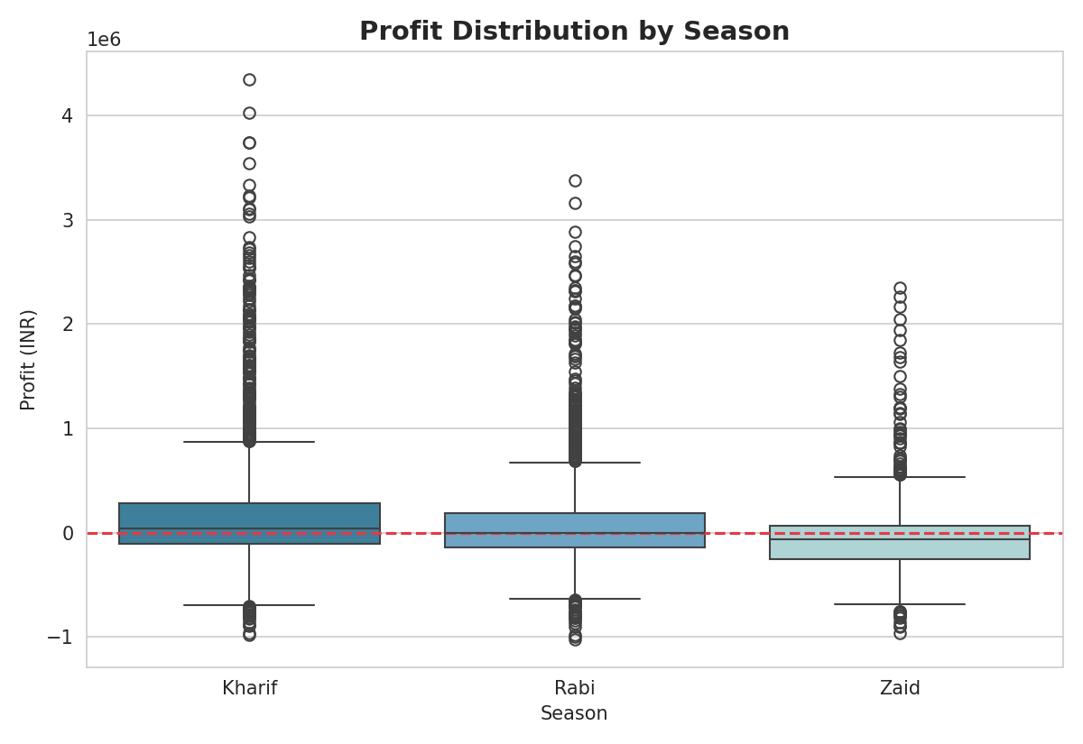
RESULTS
Q1: Profitability Varies Significantly Across Seasons
Kharif is the most profitable season (median profit ₹38,808); Zaid shows losses for most farms (ANOVA F=34.29, statistically significant).

Slide 7
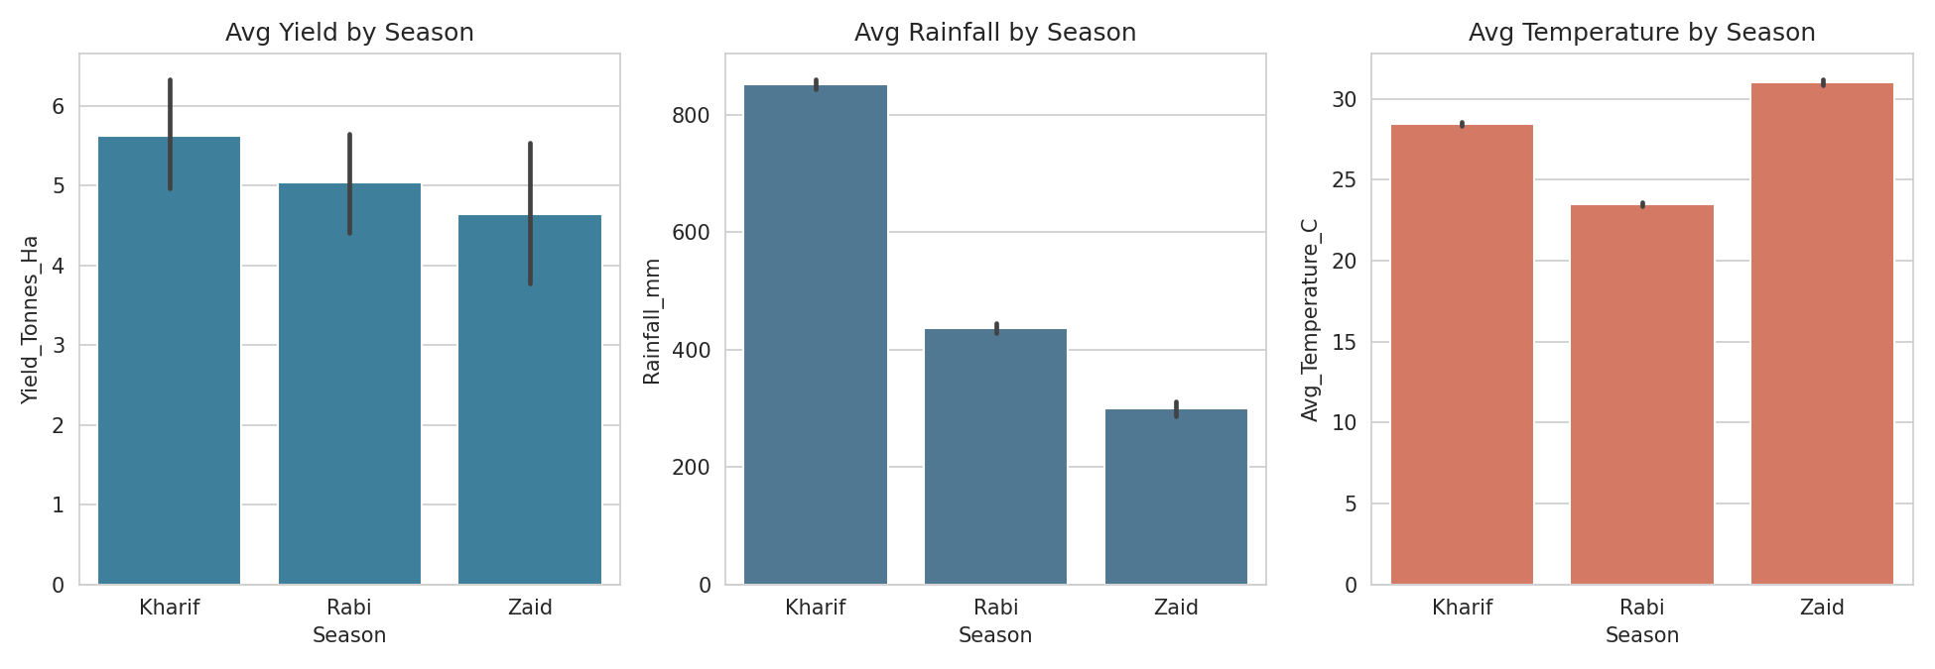
RESULTS
Q2: Yield is Driven by Rainfall, Not Just Season
Kharif has the highest rainfall (852mm) and yield (5.63 t/ha); Zaid's low rainfall (299mm) and heat (31°C) limit yield (4.64 t/ha).

Slide 8
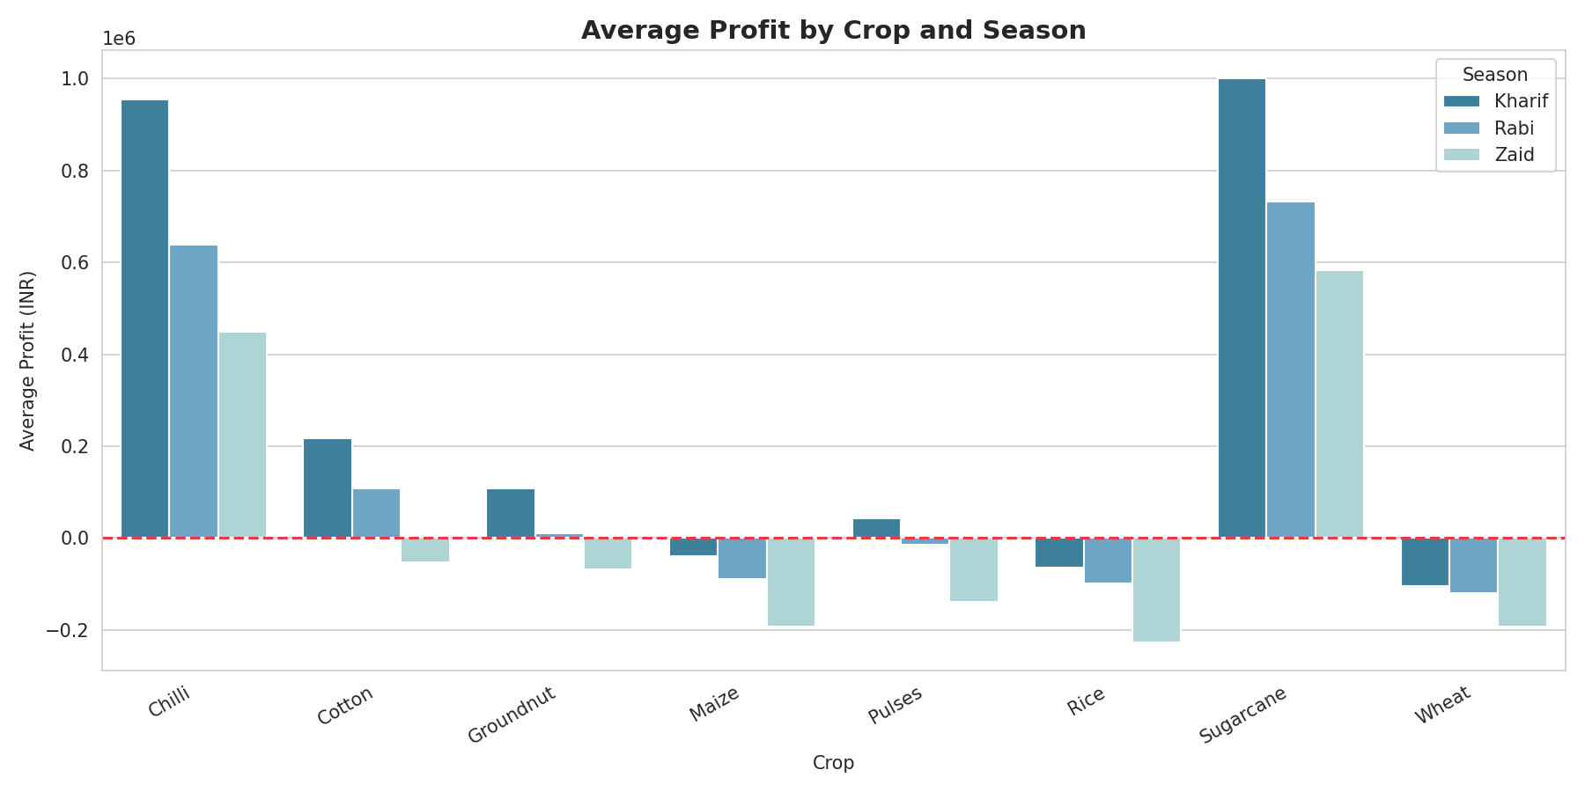
RESULTS
Q3: Cash Crops Outperform Staple Crops in Every Season
Sugarcane and Chilli are consistently the most profitable crops; Wheat, Rice and Maize show thin or negative margins across all seasons.

Slide 9
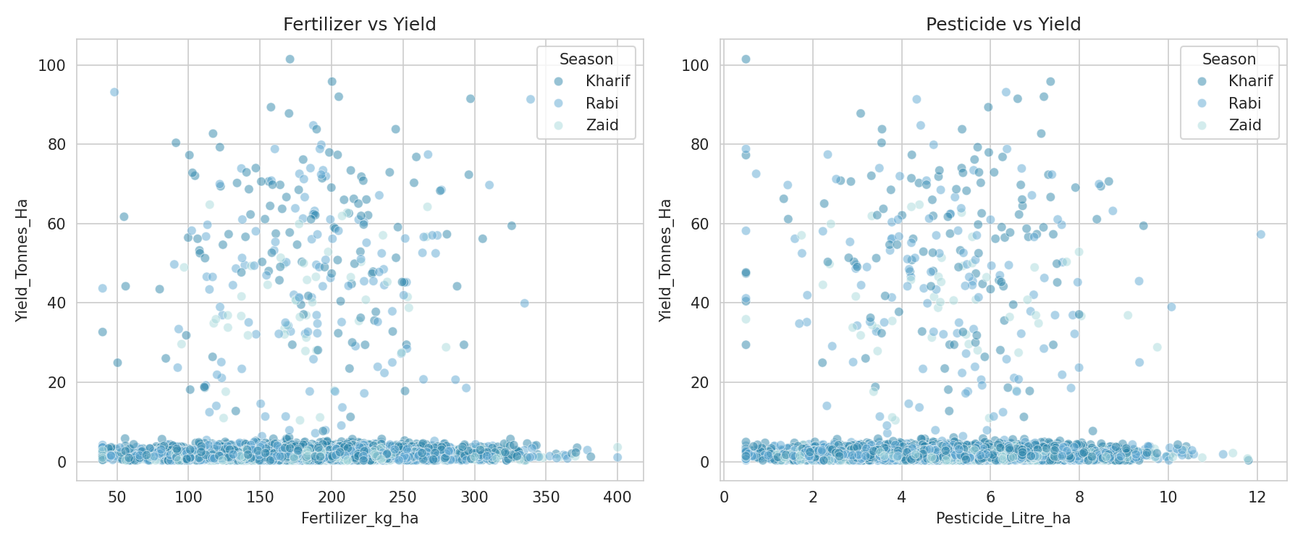
RESULTS
Q4: Fertilizer/Pesticide Usage Shows No Link to Yield
Correlations are near zero (-0.03 to +0.03) in every season — yield appears driven more by environment than input intensity.

Slide 10
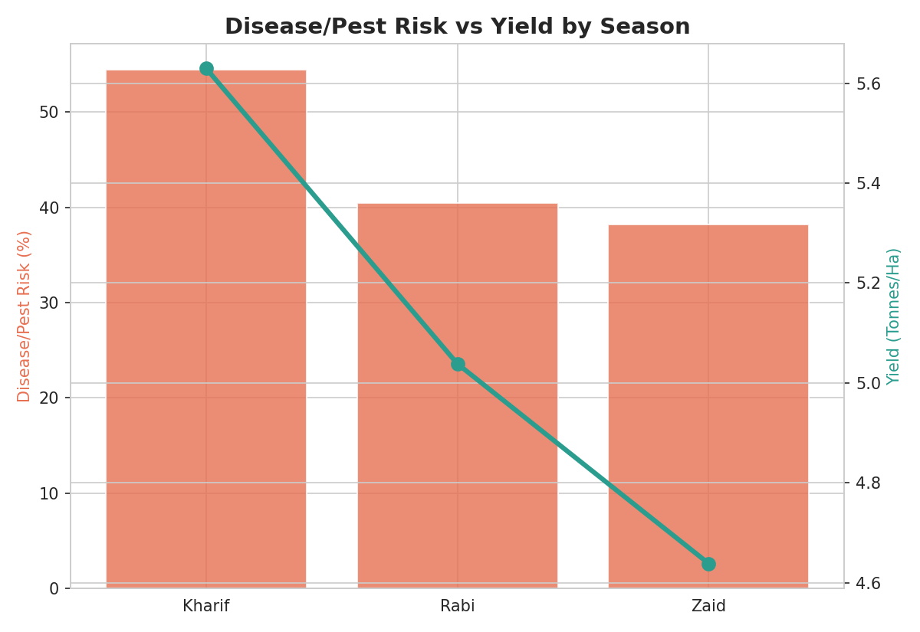
RESULTS
Q5: Pest Risk Moves With Favorable Conditions, Not Against Yield
Kharif has both the highest pest risk (54.5%) and highest yield — rainfall's benefit outweighs the added pest pressure.

Slide 11
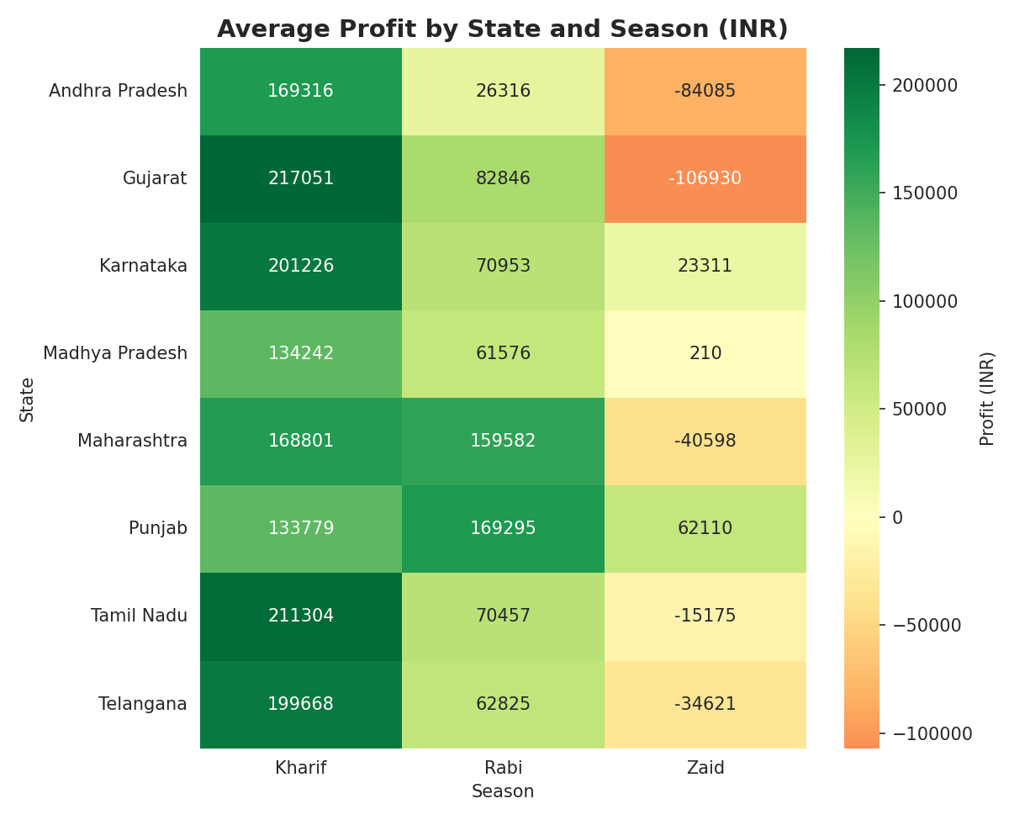
RESULTS
Q6: Most States Follow the Seasonal Pattern, With Exceptions
Punjab, Karnataka and Madhya Pradesh stay profitable even in Zaid season, unlike most other states — pointing to irrigation as a key factor.

Slide 12
Future scope
• Incorporate multi-year data to validate whether seasonal trends hold consistently over time
• Build a predictive model (e.g., regression) to forecast yield and profit from season and input data
• Develop an interactive dashboard for real-time seasonal monitoring by farmers and planners
• Extend the analysis to district-level granularity for more localized recommendations
• Study irrigation practices in resilient Zaid-season states (Punjab, Karnataka, MP) in greater depth

Slide 13
GitHub Link
[Paste your GitHub repository link here]

Slide 14

VOIS Course completion certificate -
Course name- Data Visualization

Slide 15
Thank you
.
.

